Slide 1
Last Week Quiz

Slide 2
Last Week Assignment

Slide 3
Lecture 3
Abstract Data Types

Slide 4
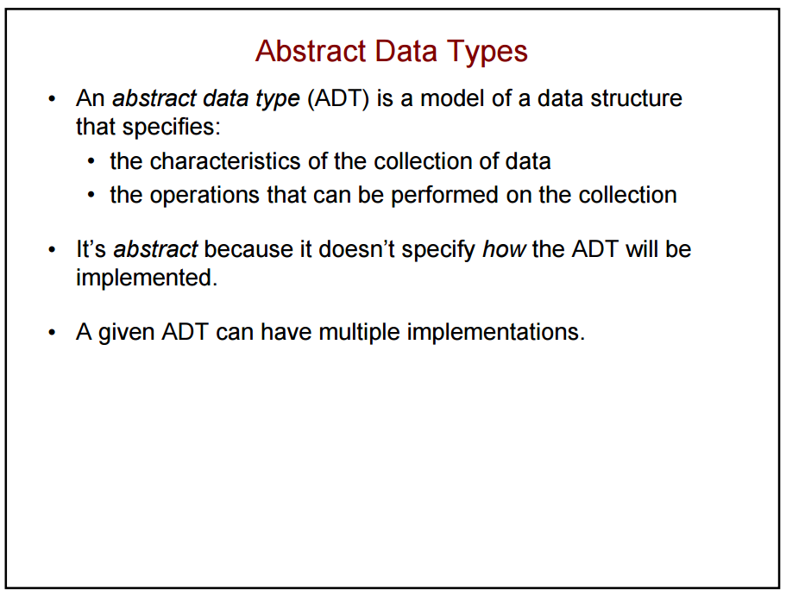

Slide 5
Abstract Data Type
Data type described by pre-defined user operations
Does not indicate how each operation is implemented
The database class that we created in Assignment 2 is an ADT
Always think about it from the user’s perspective
How will this object be used and how can we make it easier to use and modular

Slide 6
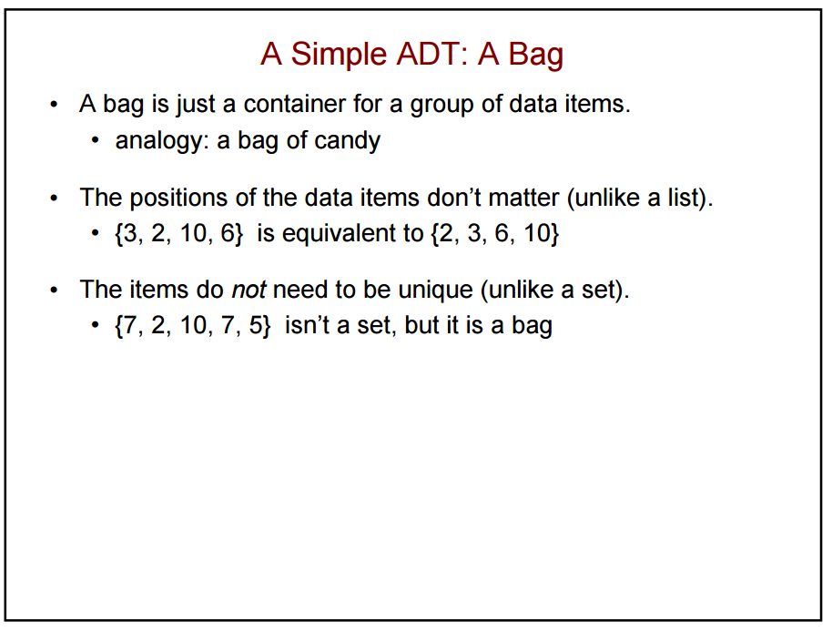

Slide 7
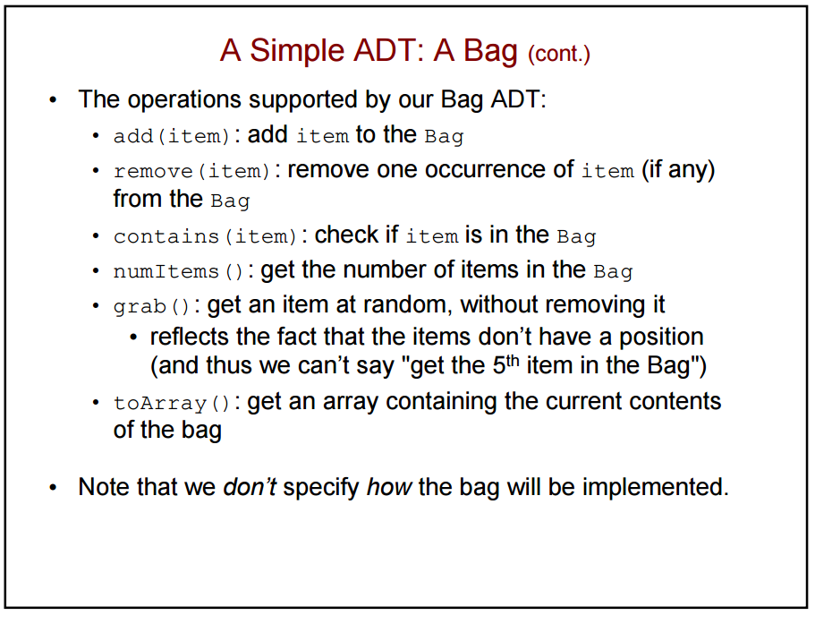

Slide 8
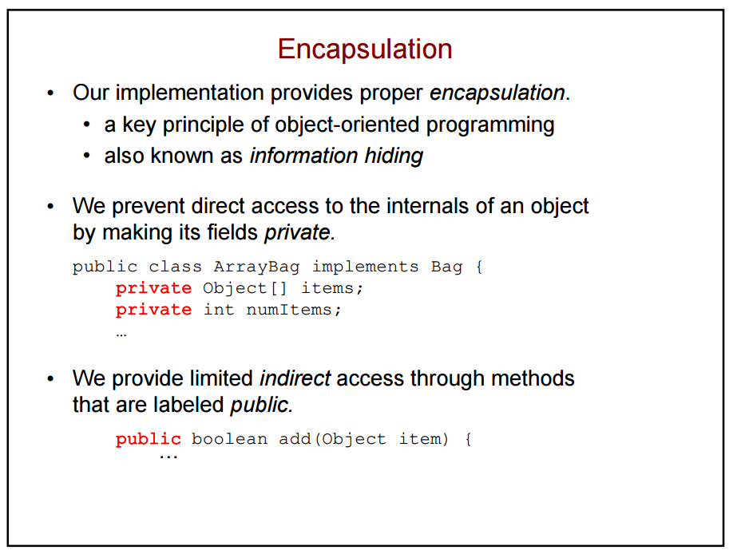

Slide 9
Example: Vending Machine
Data Type: Vending Machine
Fields:
Item quantities, cash inserted by user, change remaining, refrigeration setting, etc.
Public Methods:
vendingMachine.add(1.00)
vendingMachine.refund()
vendingMachine.getItem(“C4”)
Private Methods:
vendingMachine.setThermostat(39)
vendingMachine.outOfStock(“C4”)

Slide 10
Example: Vending Machine
We don’t need to know how the machine is accomplishing the functionality that is available through its methods
The cooling system is operating without direct interaction from the user
Would we want the user to be able to directly access or control the cooling system? What about the item quantities?

Slide 11
Lists
List is a common ADT for holding ordered data
Has several methods to append, remove, search, etc.
As the user of the list class, you don’t need direct access to the data to perform these operations (encapsulation)
The list can hold more than just simple types, it can hold entire objects
Each item is sometimes called a node

Slide 12
Lists in Java
There are two common types of lists used in Java (there are also more types)
LinkedList
Implemented as a doubly-linked list in Java
ArrayList
Implemented as a dynamically re-sizing array in Java

Slide 13
ArrayList
ArrayList offers fast random access to elements
You can access any element in constant time
Can only store reference types, not primitive types
So it can’t hold int, double, char, etc.
Instead we must use wrapper classes for these primitive types
https://docs.oracle.com/javase/8/docs/api/java/util/ArrayList.html

Slide 14
Fun Interactive Example
ArrayList

Slide 15
Singly-linked List
Each node has data and a pointer to the next node
First node called the “head”, last called the “tail”
Object contains pointers to the first node and last node for searching, appending, prepending, etc

Slide 16
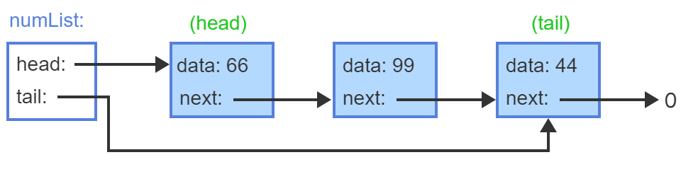
Singly-linked List

Slide 17
Singly-linked List
Appending a node updates the previous tail’s pointer to point to the new node
Prepending a node updates the head pointer to point to the new node and then its pointer points to the previous head node
Removing a node will remove it and update the previous node’s next pointer
Inserting creates node in middle of chain and updates appropriate pointers

Slide 18
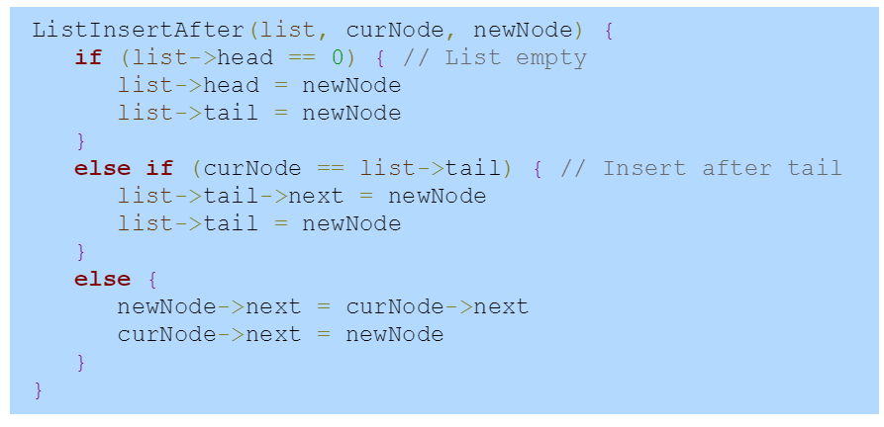
Singly-linked List Insert

Slide 19
Doubly-linked List
Similar to singly-linked list except each node has a pointer to the node before it and after it
This allows for traversing the list in two directions
Append, prepend, remove, etc., all behave similarly but have to update pointers to the next and the previous nodes

Slide 20
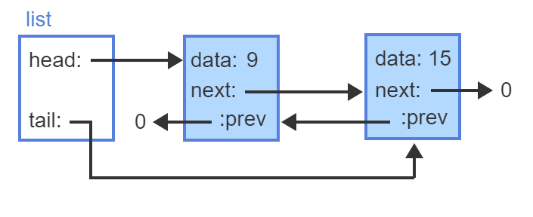
Doubly-linked List

Slide 21
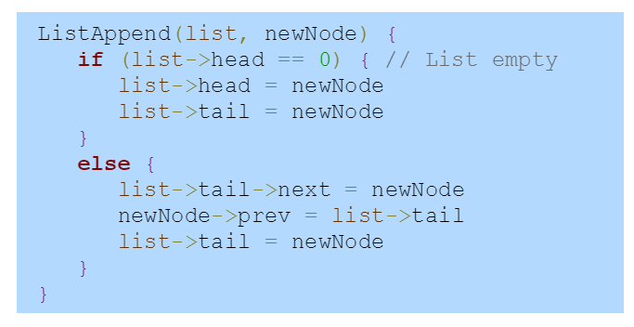
Doubly-linked List: Append

Slide 22
Lists in Java
Generally, ArrayLists are preferable in most of our use cases
If a lot of data will be frequently added, allocating space for a new larger array every time and copying the old one into it can be expensive
Some additional space is allocated above what is necessary to store the data to mitigate this
LinkedList offers constant time to add new elements to head or tail
ArrayList must shift everything when you add to head

Slide 23
Lists in Java
Generally speaking, we will not be concerned with the performance differences of these two types of lists
We are more concerned with the usage of these objects to accomplish our programming goals

Slide 24
Quiz this Week
Lists
Due next Tuesday 11:59pm

Slide 25
Assignment 4: Lists
Due next Tuesday 11:59pm

Slide 26
Zybooks Sections
2.1 – 2.7, 2.16, 2.23

